Slide 1



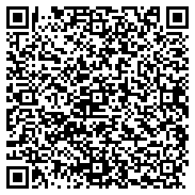

STARTING SOON!
Apply now: ftlcity.info/startupftl
Notes:
This slide allows you to personalize your deck to your target audience and/or add your own organizational branding alongside Kauffman FastTrac embedded logo. Be sure to keep the Kauffman FastTrac logo visible.
2

Slide 2


Brought to you by the City of Fort Lauderdale
Applications Due Friday, December 6 at 11:59pm EST
Notes:
This slide allows you to personalize your deck to your target audience and/or add your own organizational branding alongside Kauffman FastTrac embedded logo. Be sure to keep the Kauffman FastTrac logo visible.
3

Slide 3
Agenda
  Meet the Public Affairs Team
  StartUp FTL Program
  Business Functions
  Business Stages
  Program Modules
  Application Process
  Application Questions
  Course Details
  Course Eligibility
  What to expect?
  Course Timeline
  Q&A
Notes:
This slide allows you to personalize your deck to your target audience and/or add your own organizational branding alongside Kauffman FastTrac embedded logo. Be sure to keep the Kauffman FastTrac logo visible.
4

Slide 4
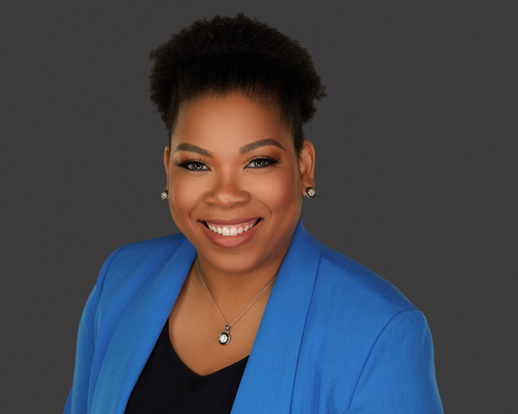
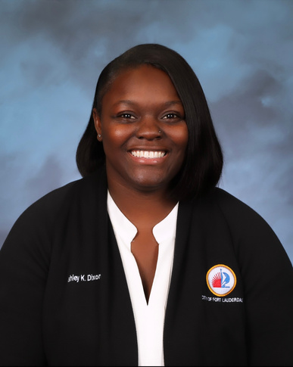
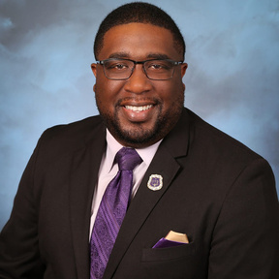
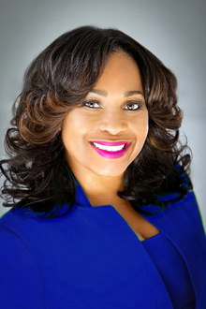
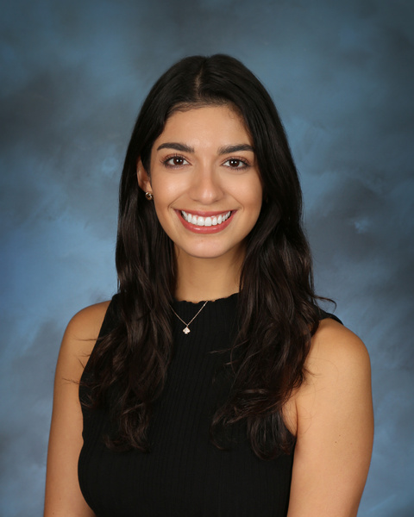

City of Fort Lauderdale Public Affairs
Daphnee Sainvil
Division Manager
Von Howard
Ashley Dixon
Administrative Supervisor
Management Analyst
Melissa Mata
Nikki Austin-Shipp
Sr. Management Fellow
Administrative Aide
Notes:
Melissa Mata’s Background
City of FTL fellow
Former Economic Development Specialist in Sahuarita Az – GrowINSahuarita
5

Slide 5
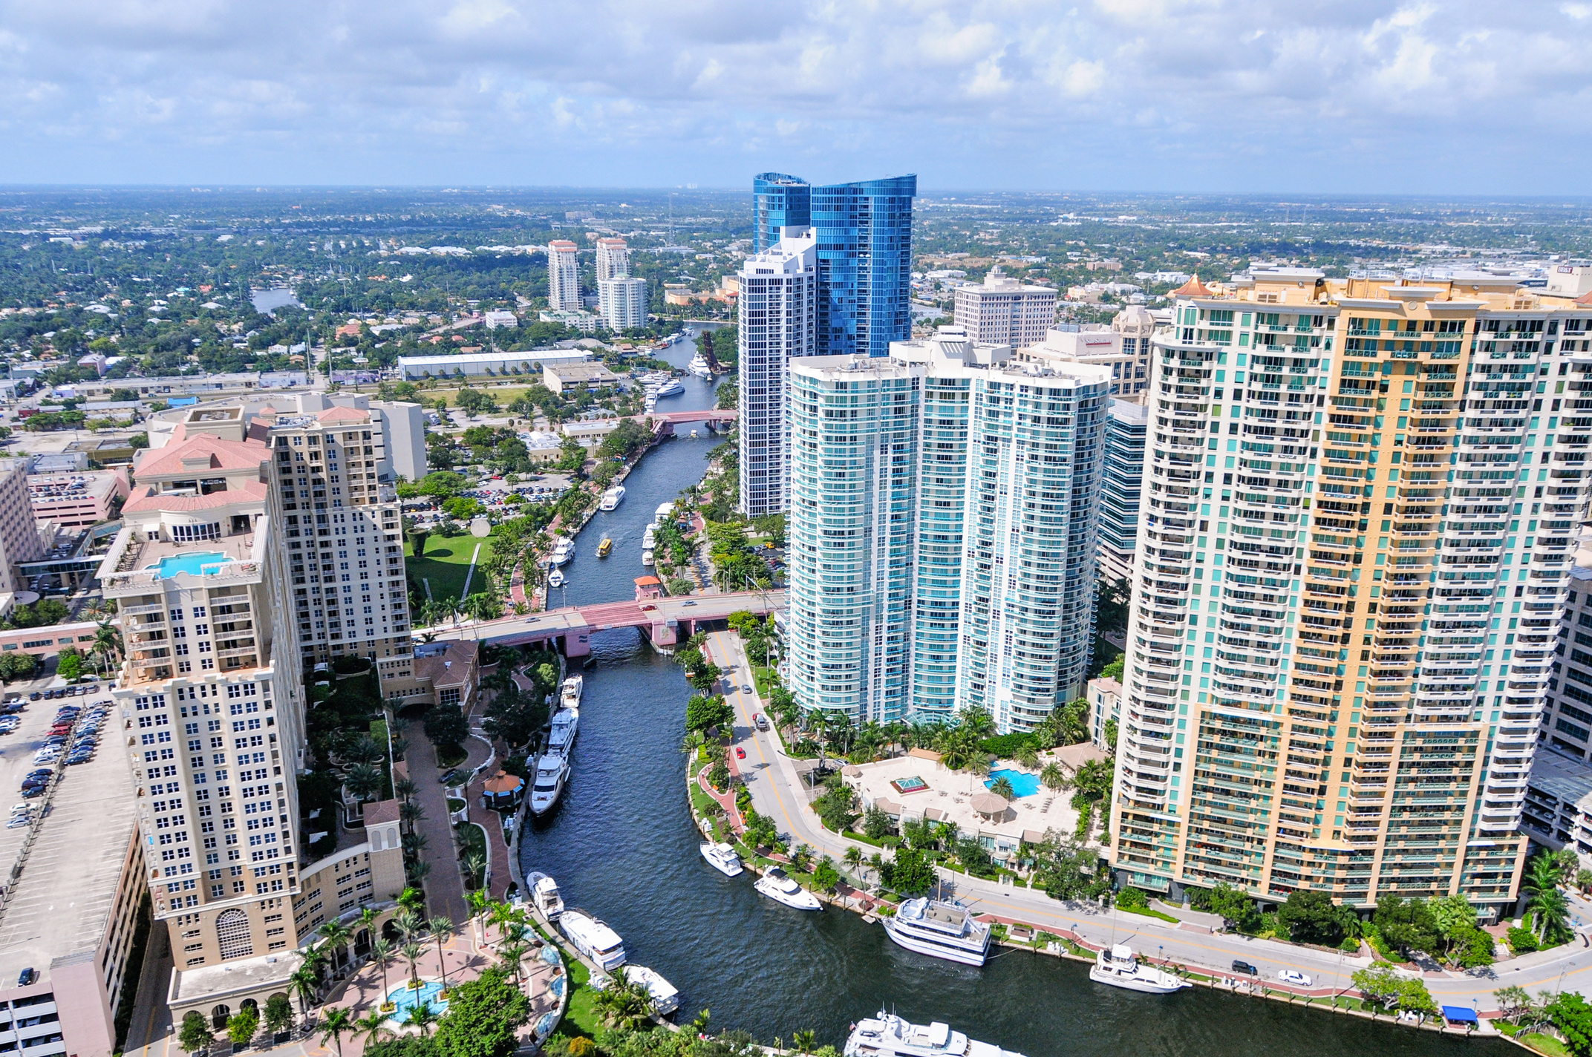

Economic Development
Dedicated to cultivate and build strong relationships with the business community as the primary point of contact in all phases of business growth.
The Division focuses in fostering entrepreneurship and education for small and medium-sized businesses.
Government & International Affairs
The Division partners with international consulates and embassies for advocacy and economic advancement. Serves as a liaison between the city and other levels of government, as well as external stakeholders.

Slide 6

What is StartUp FTL?
Designed specifically for Fort Lauderdale's entrepreneurs, the StartUp FTL program ensures that the skills acquired are directly applicable to participants' business operations. Recognizing the unique challenges faced by business leaders, the program focuses on essential business functions critical for achieving operational success.
The program’s 12-week hybrid format includes both in-person and digital sessions to provide flexibility. Participants will engage with modules from the renowned FastTrac Kauffman Business curriculum. Thanks to funding from the City of Fort Lauderdale Public Affairs Division, this valuable resource is available at no cost to participants.
Our goal is to empower local entrepreneurs and foster a vibrant entrepreneurial ecosystem within the community.

Slide 7
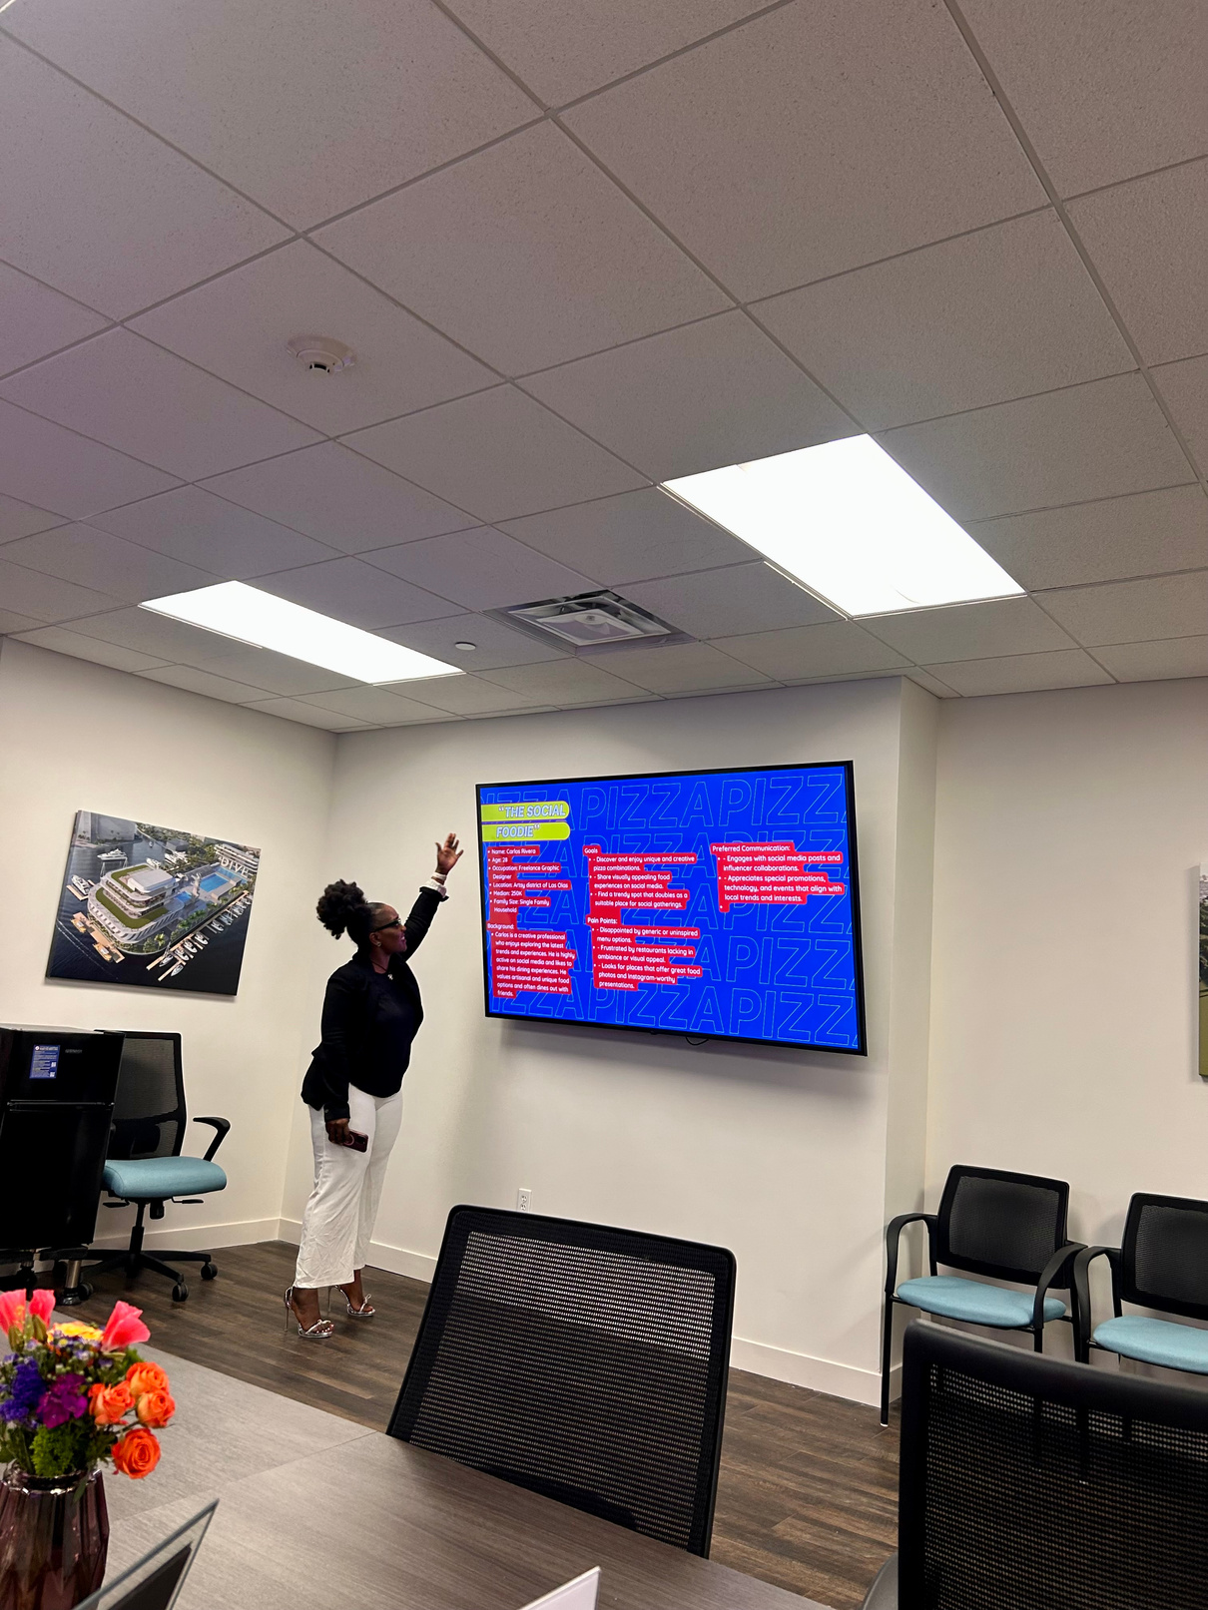
1. Vision Statement
2. Work-life Balance
3. Business Administration
4. Business Production
5. Customer Service
6. Sales
7. Business Operations
8. Human Resources
9. Business Financials
10. Marketing
11. Exit Strategies
12. Assets
13. Market Analysis
STARTUP FTL BUSINESS FUNCTIONS

Slide 8




BUSINESS STAGES
Ideation
Incubation
Acceleration
Transition
An individual has an
idea for a business
but needs help to
determine if the
idea can become a
sustainable
business.
The individual feels
confident enough to
take the ‘Idea’ and
turn it into an early
phase start-up
business.
The business has
survived beyond
start-up and wants
to take the necessary steps to
position itself for long-term
sustainable growth.
The business has
matured to the point where the owner needs to plan how to successfully exit
the business to keep the business, or legacy, alive.

Slide 9

BUSINESS STAGES
Ideation
Incubation
Acceleration
Transition
An individual has an
idea for a business
but needs help to
determine if the
idea can become a
sustainable
business.
The individual feels
confident enough to
take the ‘Idea’ and
turn it into an early
phase start-up
business.
The business has
survived beyond
start-up and wants
to take the necessary steps to
position itself for long-term
sustainable growth.
The business has
matured to the point where the owner needs to plan how to successfully exit
the business to keep the business, or legacy, alive.

Slide 10







Participants will determine whether they are ready to launch their business. Participants will explore a “launch checklist” to ensure maximum marketing impact with the minimum amount of resources.
The Kauffman FastTrac curriculum teaches aspiring, early-stage entrepreneurs how to launch their businesses.
Participants will write and refine their business plan that will guide the launch of the business. This encompasses building the business structure. Finally, participants will identify the appropriate funding sources to reach financial goals and build profit.
5 Modules - 12 Weeks
Participants will learn how to sell and distribute their product/service identifying the best marketing strategies. Participants will learn how to build their best sales team and how to implement their business brand into their business processes.
Launch
Participants will explore strategies to identify and evaluate opportunities for business start-up and growth. Participants will learn how to conduct market research to understand their industry.
Refine
Participants will develop and refine their business idea. The lessons will provide tools to evaluate the feasibility of their business concept before building a business plan.
Commit
Position
Ideate

Slide 11



Application Process
1
2
3
4
5
Applications Open
Information Session
Applications Close
Review of Applications
Notification of Acceptance
December 6, 2024 at 11:59pm EST
November 11, 2024
November 20, 2024
Week of December 16
Week of January 6, 2025

Slide 12





Application Questions
1
2
3
What challenges is your business currently experiencing, and why are these issues important/impactful for your business?
Describe the type of products or services your business offers.
Describe how your business serves the people of Fort Lauderdale.

Slide 13

Application Question
Are you providing a service or selling a product?
1
2
What is your business about?
Describe the types of products or services your business offers.
Consider this question as a sales pitch. How are you describing your business?
3

Slide 14
Application Question
1
What is keeping you up at night?
Explain in detail your business challenges and how solving them will help your business become successful.
2
What challenges is your business currently experiencing, and why are these issues important/impactful for your business?
The more you describe your challenges the more we can understand how to help.
3

Slide 15
Application Question
1
Who are your clients?
Explain how and why your business keeps your clients happy.
2
Describe how your business services the people of Fort Lauderdale.
3
Explain how your business serves the community of Fort Lauderdale.

Slide 16
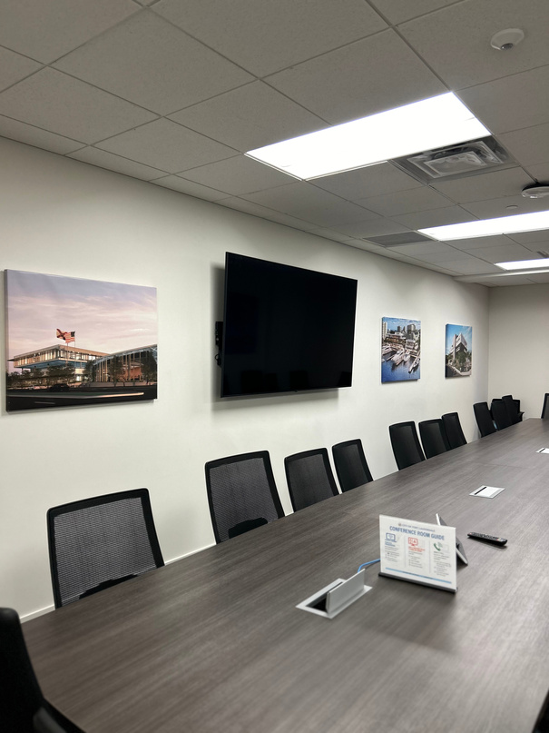
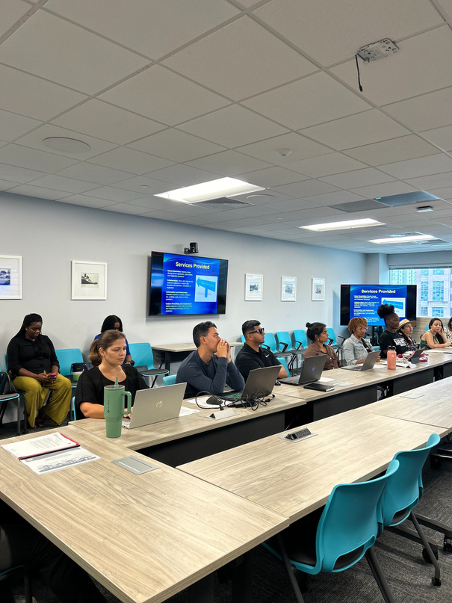
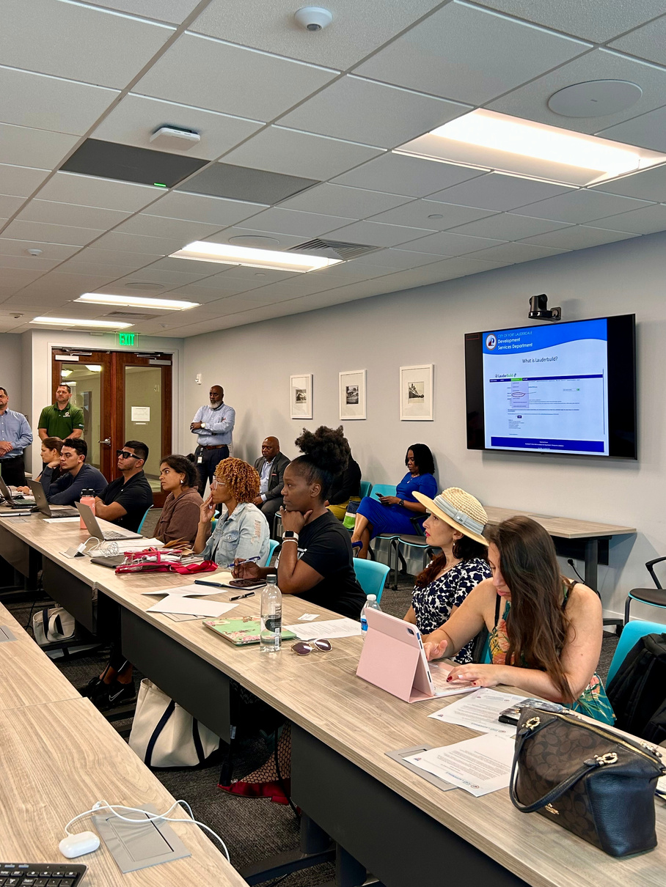
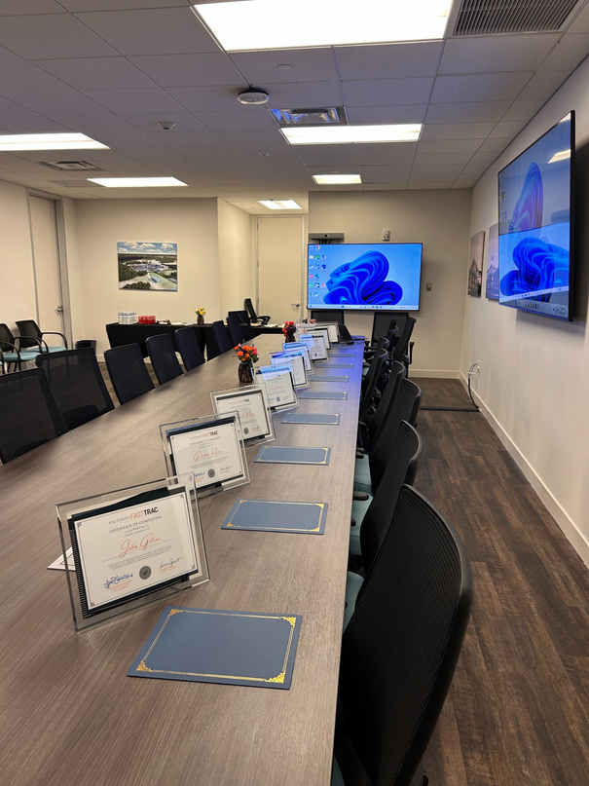
COURSE DETAILS
Hybrid Program
Orientation
Course Begins
Course Length
City Office
January 23, 2025
February 5, 2025
12 Week Program
101 NE 3rd Ave,
Fort Lauderdale, 33301
or via
8 weeks in person
4 weeks online
6:00 PM - 7:00 PM
Wednesdays & Thursdays
6:00 PM - 8:00 PM
Zoom
Schedule may be subject to change*

Slide 17
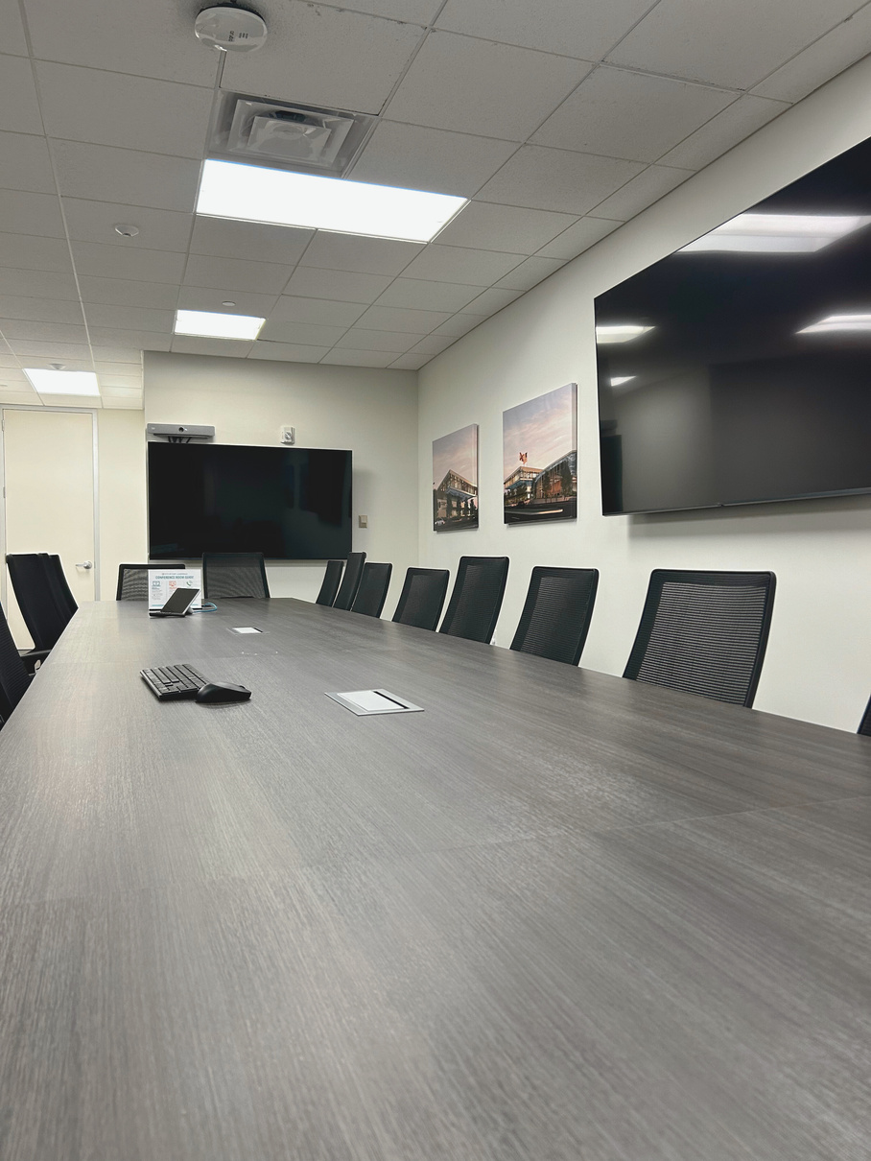



COURSE ELIGIBILITY
WHO IS ELIGIBLE?
WHAT DO I NEED?
  Live or do business in the City of Fort Lauderdale
  Have an idea or an established business in the City of Fort Lauderdale
  Commitment to attend all sessions and complete program assignments
  A well-researched idea for a new or current business
  Access to a laptop or device to complete in-class and after-class assignments

Slide 18

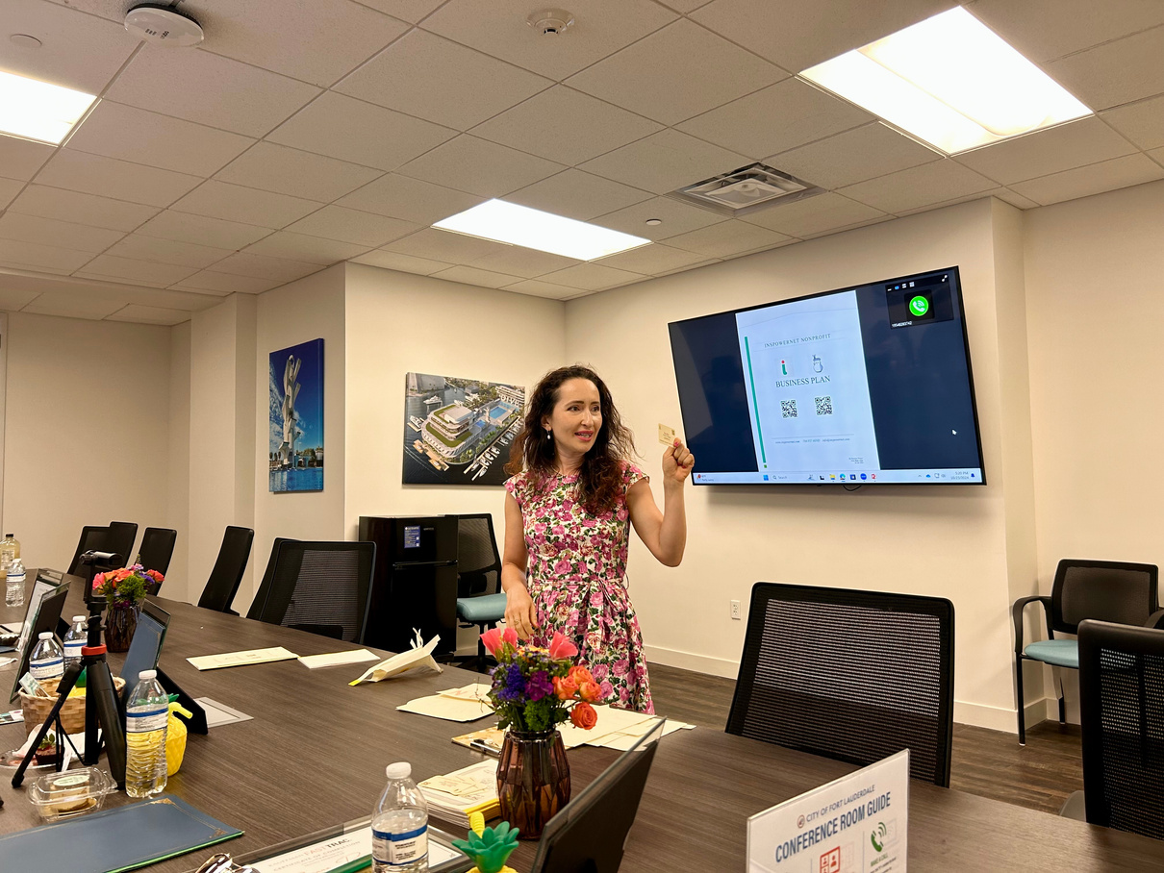
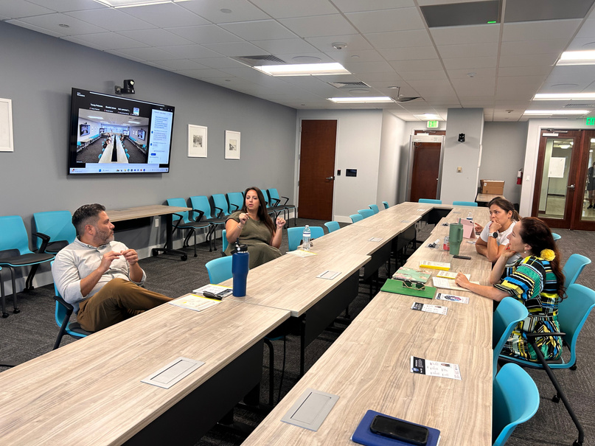
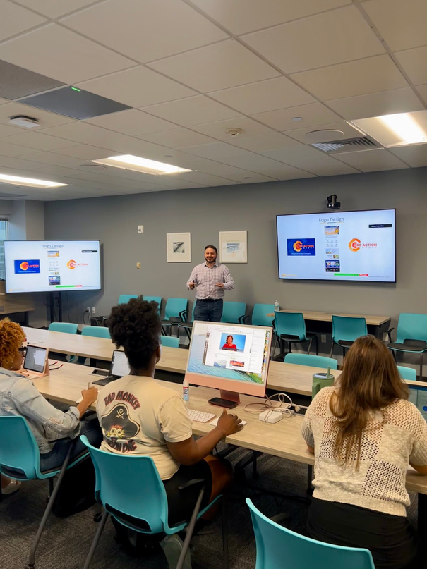
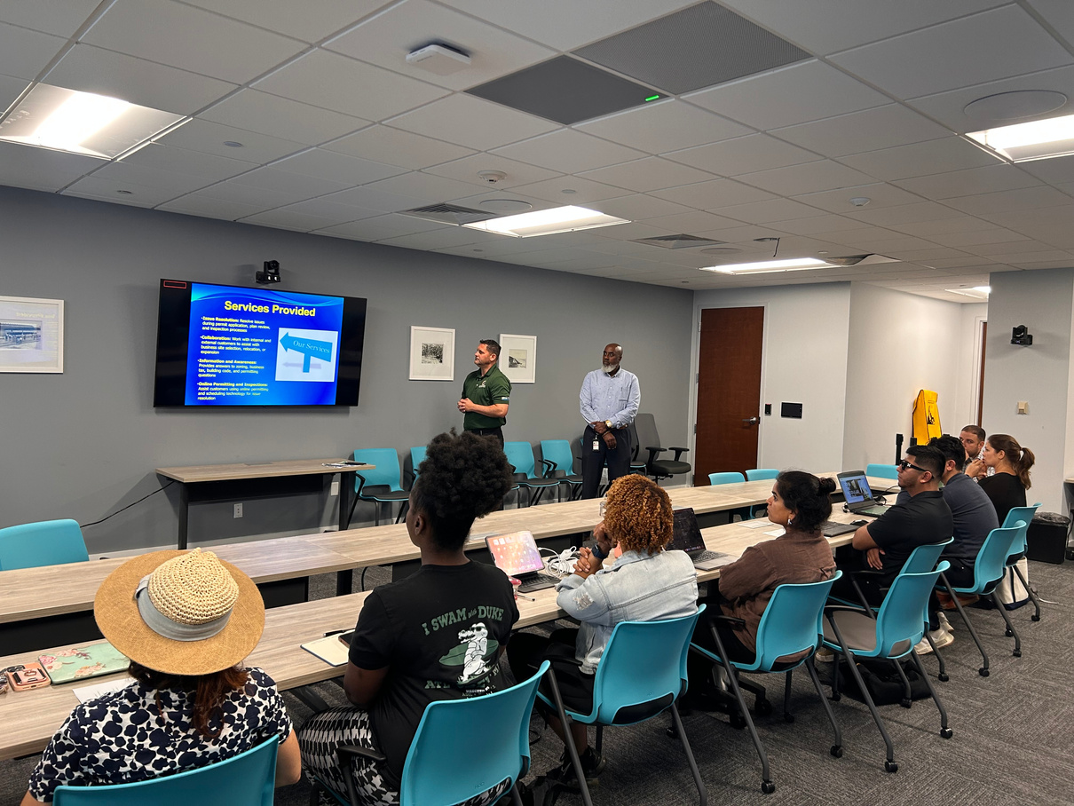

Course classes will be Wednesdays & Thursdays for 2 hours
1
Learn from local experts and business leaders!
2
Complete a market analysis, business plan, & identify your business goals
3
What to Expect?
4
Connect with local entrepreneurs!
Business Plan presentation at the end of the course
5
Learn about local, county, and South Florida resources
6

Slide 19
Course Timeline
 | FEBRUARY | FEBRUARY | MARCH | APRIL
IDEATE
POSITION
POSITION
POSITION
COMMIT
COMMIT
COMMIT
REFINE
REFINE
REFINE
LAUNCH
LAUNCH
LAUNCH
Schedule may be subject to change*

Slide 20
Applications Close Friday,
December 6 @ 11:59pm
Apply now: ftlcity.info/startupftl
Contact Information:
Program Coordinator
Melissa Mata
MMata@fortlauderdale.gov
(954) 828-6182
Notes:
This slide allows you to personalize your deck to your target audience and/or add your own organizational branding alongside Kauffman FastTrac embedded logo. Be sure to keep the Kauffman FastTrac logo visible.
2

Slide 21
Apply now: ftlcity.info/startupftl
Applications Close Friday,
December 6 @ 11:59pm
Notes:
This slide allows you to personalize your deck to your target audience and/or add your own organizational branding alongside Kauffman FastTrac embedded logo. Be sure to keep the Kauffman FastTrac logo visible.
2

