Slide 1
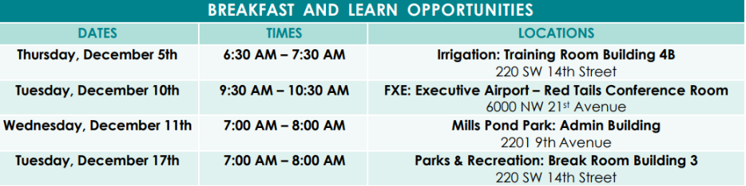
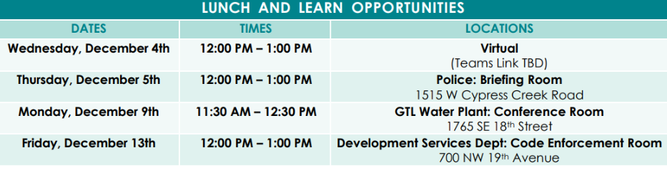
Quarter 4: Financial Wellness Budgeting and Financial Planning
Hosted By Michelle Harrington Sr. Partner Company Advisor, Jessica Law, MPH, CHES the City’s Cigna Well-Being Coordinator and Mia Daniels, HR Benefits Assistant

Slide 2

Health Fair Feedback
For those that attended our 2024 Health Fair We would love your feedback on:
Food
Vendors
Goodie Bags
Raffle Prizes
Music
Games

Slide 3

FSA Reminder
For the 2025 Plan Year there will be a new third-party provider administering Health Care FSA and Dependent Care FSA. Anyone who enrolls in an FSA for 2025 will be provided with a new benefits debit card from TASC to use for eligible expenses incurred in plan year 2025.
As a current enrollee on one or both accounts with an available balance (as of November 25th), you are encouraged to use up your funds by December 31, 2024. Otherwise, you may be managing two separate debit cards during the IRS allowed grace period.

Slide 4


Aflac Claim Reimbursement
Group Critical Illness
Includes a $50 benefit payable once per calendar year for covered wellness tests (mammogram, colonoscopy, EKG and many other) **Payable to employee and spouse only
Group Accident Benefit Includes a $50 wellness benefit payable twice per year per insured for wellness tests. (mammogram, colonoscopy, EKG and many others)** Payable to employees, spouse, and children
** You can go back up to 5 years to file claims for all wellness claims

Slide 5
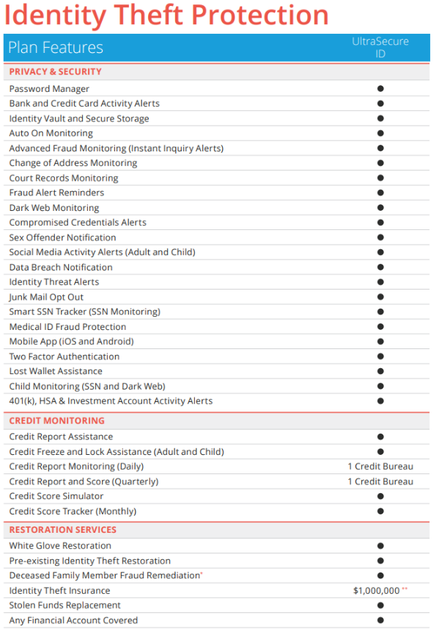
Identity Force
Identity Theft Protection is available to Employees Enrolled in the City's Health Plan at No Additional Cost
Now is the time to protect what is most important. As our digital footprint expands, fraud and scams increase exponentially, along with vulnerabilities that result from having sensitive personal information exposed. It’s why IdentityForce offered through Cigna will be included in your Cigna medical coverage at no additional cost. IdentityForce is here to provide you with award-winning identity theft protection built to proactively monitor, alert, and help fix any identity theft compromises.
IdentityForce is:
Available to City employees who are enrolled in the City's health plan at no additional cost
Award-winning identity theft protection built to proactively monitor, alert, and help fix any identity theft compromises.
How do I sign-up for IdentityForce Identity Theft Protection?
Visit https://cigna.identityforce.com/starthere or call 833-580-2523.
Once you complete the registration, you can access your dashboard. Your dashboard displays the monitoring scans that IdentityForce is doing to protect you.

Slide 6
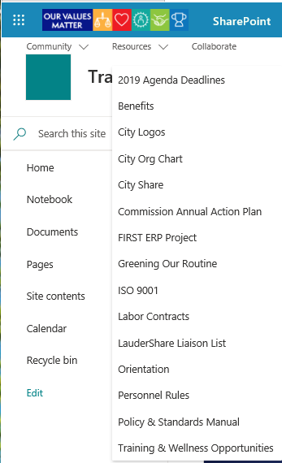
Benefits Calendar
Go to Laudershare
Click on the drop-down
menu under “Resources”
and click on “Training &
Wellness Opportunities”

Slide 7

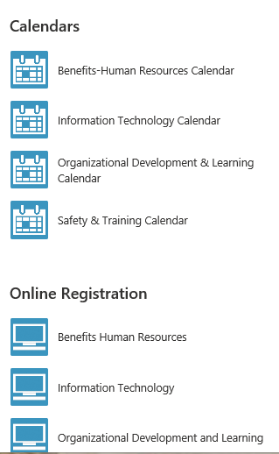
Benefits Calendar
Click on “Benefits-Human Resources Calendar”

Slide 8

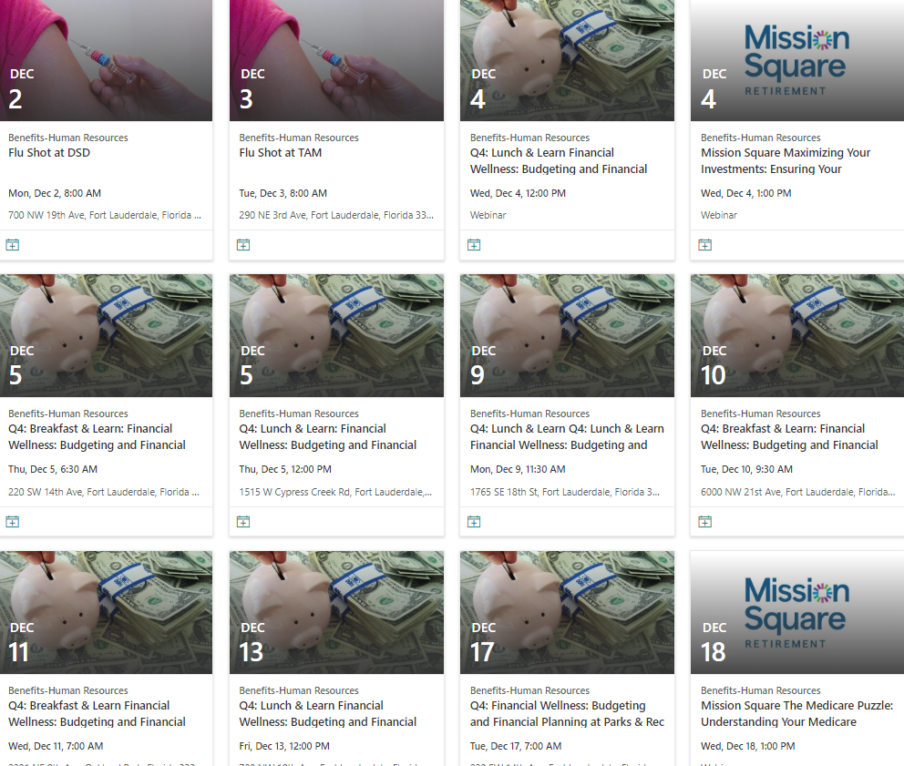
Benefits Calendar
See all the upcoming events!

Slide 9
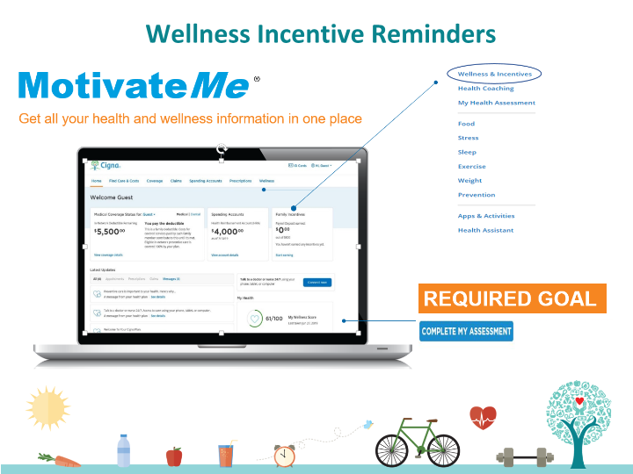

Slide 10
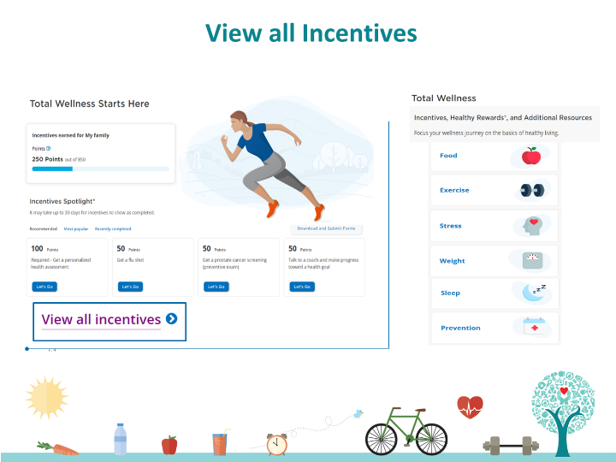

Slide 11
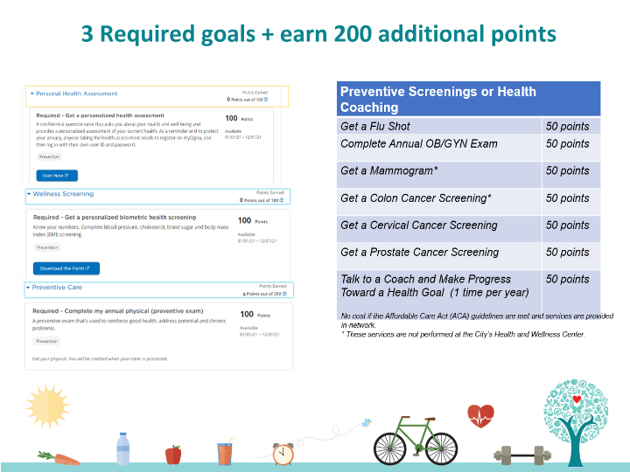

Slide 12
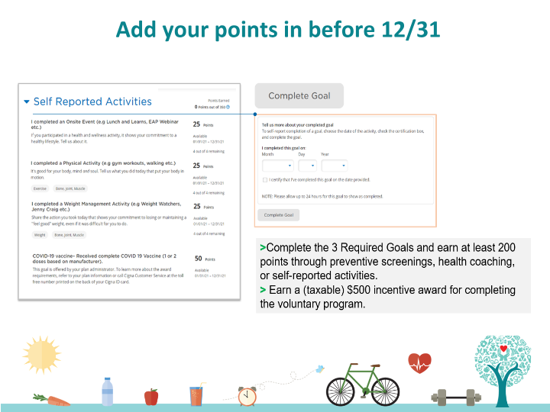

Slide 13

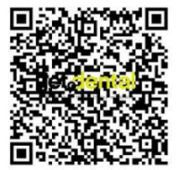
JetDental is coming to FTL
We’re excited to bring back a great benefit for all team members. Jet Dental- a professional dental team- will be coming to provide comprehensive exams, cleanings, and x-rays for all our staff and their dependents
Friday, Dec 13th
9:00 am -5:00 pm
101 Tower (11th Floor Conference Room)
801.430.9262

Slide 14
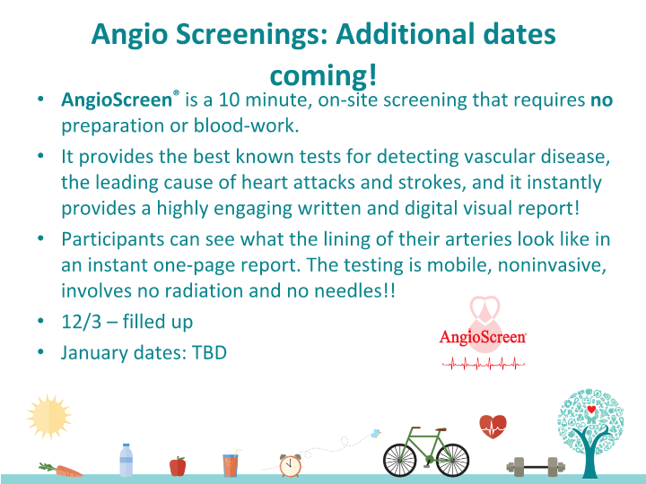

Slide 15


Slide 16


Slide 17


Slide 18


Slide 19
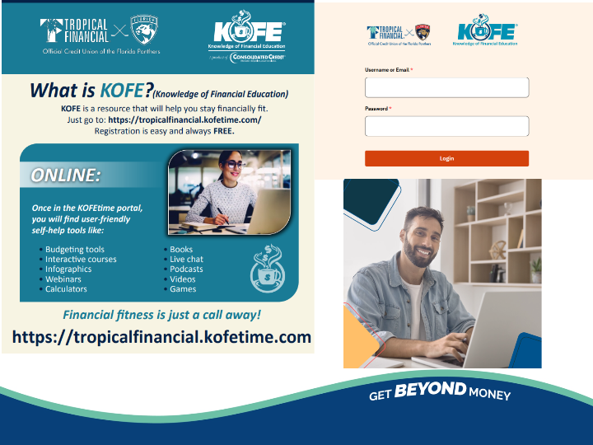

Slide 20


Slide 21
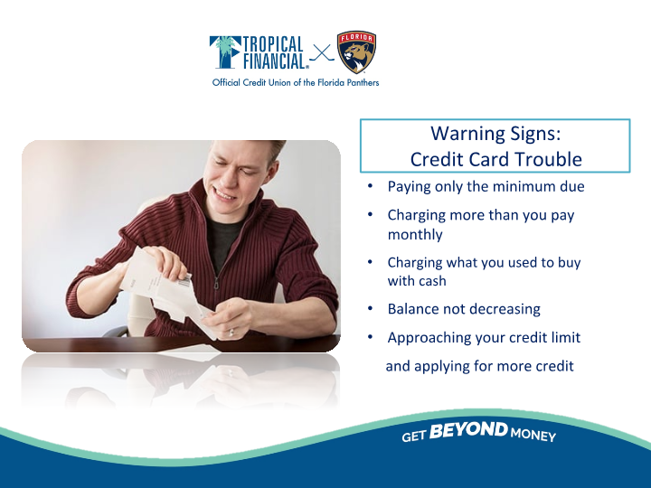

Slide 22


Slide 23


Slide 24
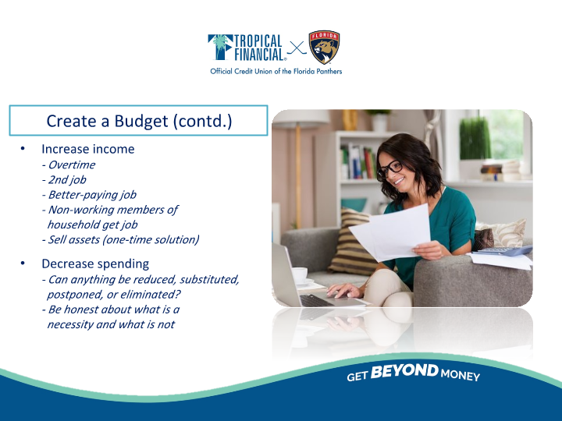

Slide 25


Slide 26


Slide 27


Slide 28
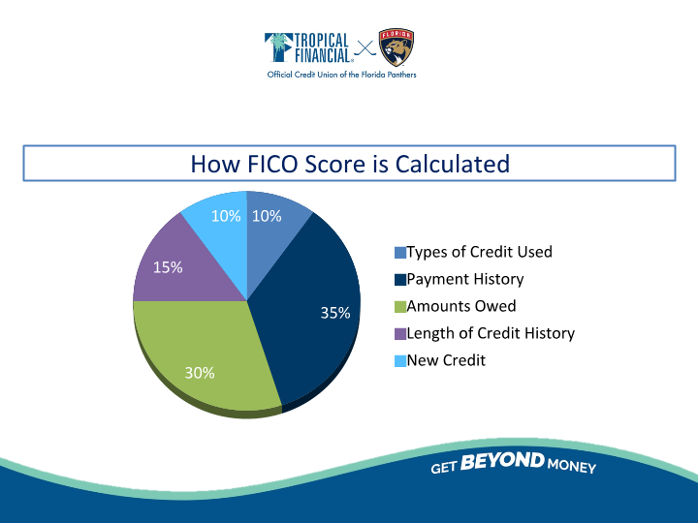

Slide 29


Slide 30


Slide 31


Slide 32


Slide 33


Slide 34
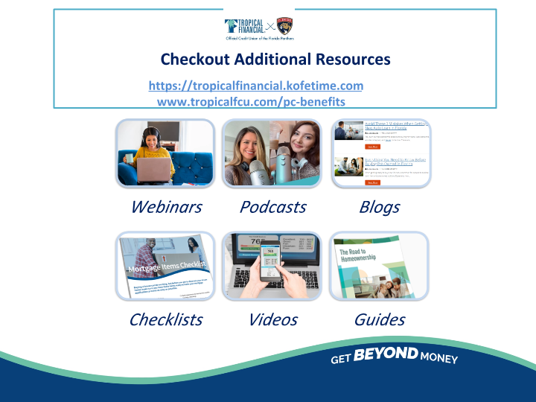

Slide 35


Slide 36
