Slide 2
Agenda
1
PROJECT BACKGROUND
2
SCOPE SUMMARY
3
NEXT STEPS
4
STAKEHOLDER INPUT

Slide 3
Project Background
Project Study Roadways:
  Andrews Avenue
  SE 3rd Avenue
Project Limits:
  Sunrise Boulevard
  SE 17th Street
Study Intersections: 31
Project Purpose: Evaluate conversion of Andrews Avenue and SE 3rd Avenue to one-way roads in project limits, focus on:
  Multimodal (pedestrian, transit, freight, and vehicular) level of service
  Stakeholder Impact
  Access and Circulation
  Delays and Queues

Slide 4
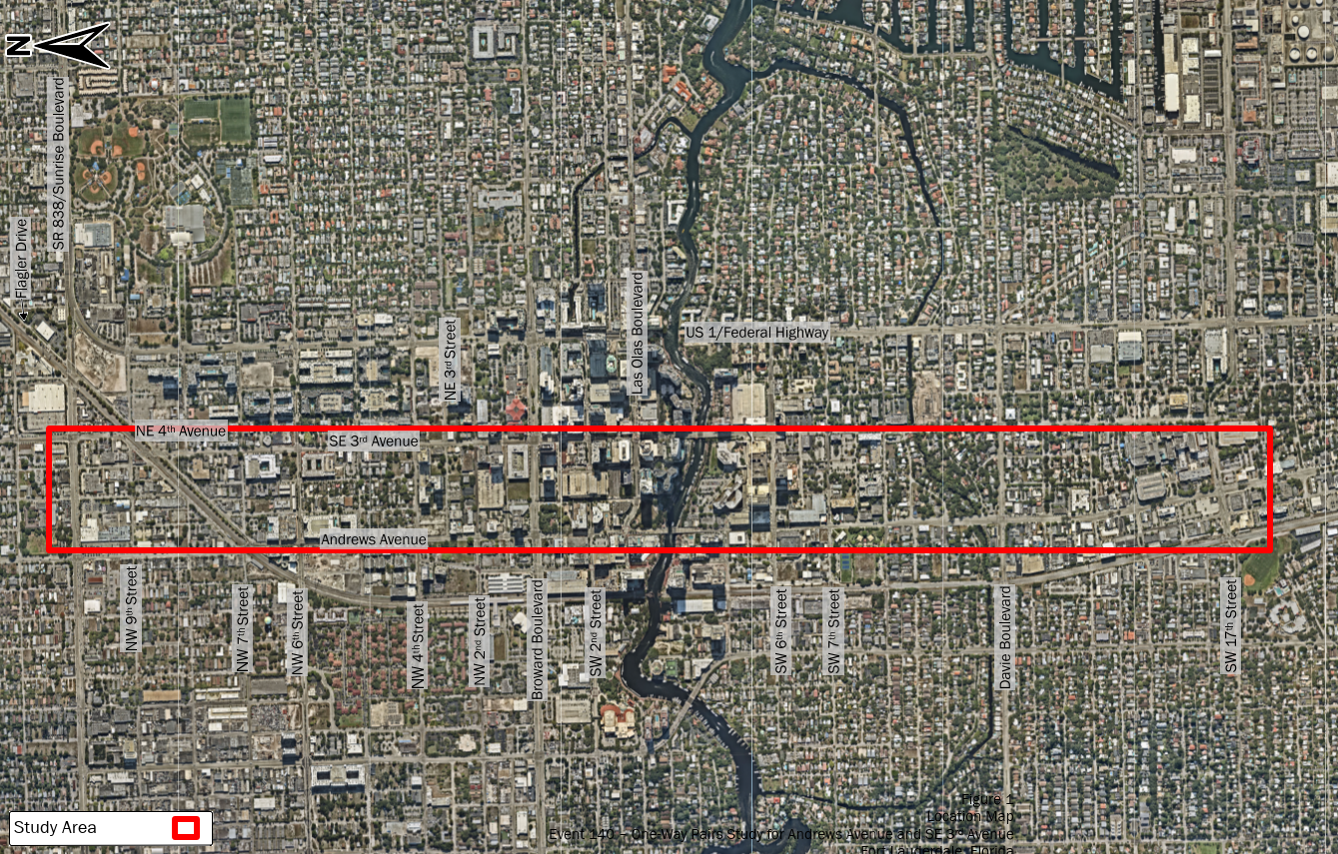
Project Location Map

Slide 5
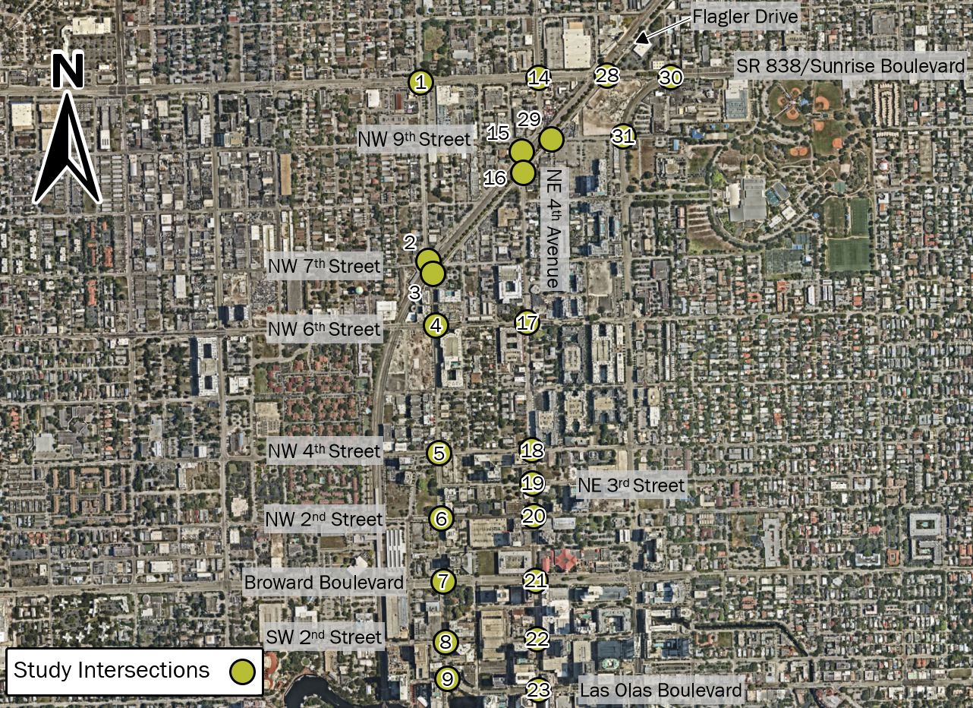
Project Location Map (north of New River)

Slide 6
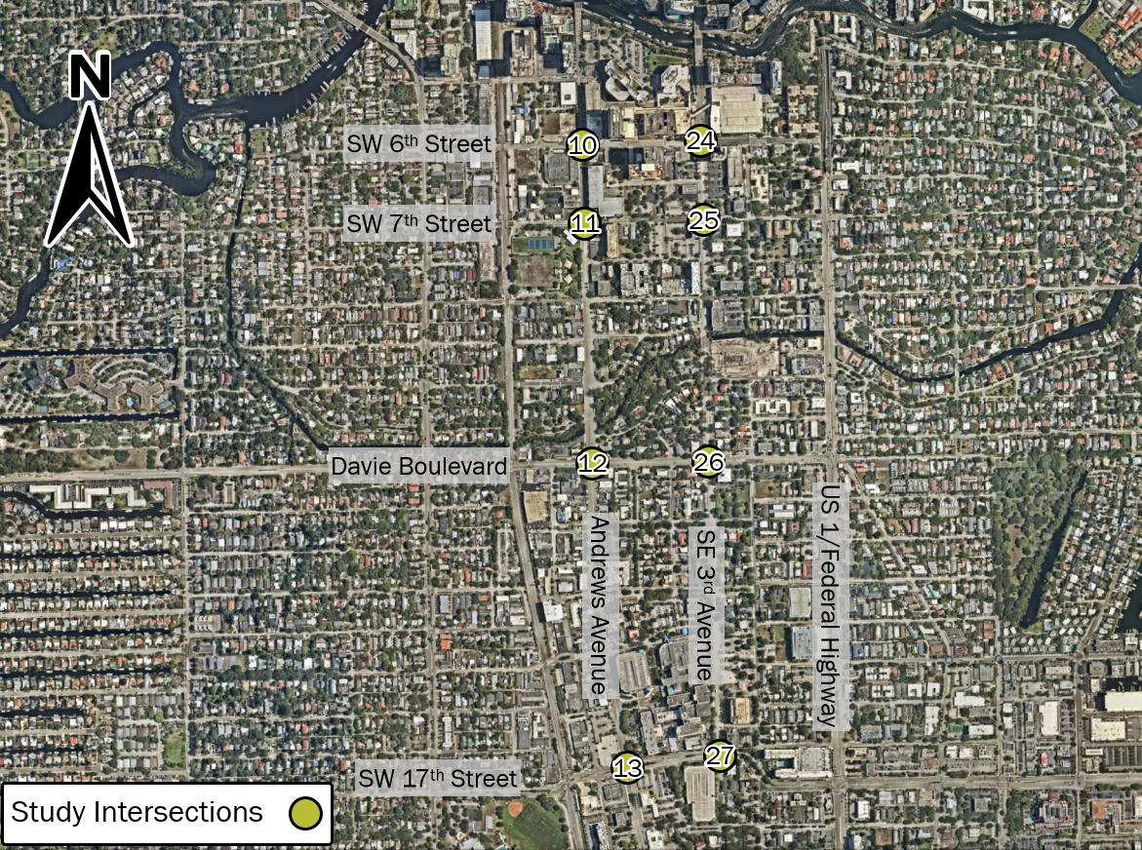
Project Location Map (south of New River)

Slide 7
Project Background
Analysis Scenarios:
  Scenario 1 (Counterclockwise Flow):
    Andrews Avenue Southbound
    3rd Avenue Northbound
  Scenario 2 (Clockwise Flow):
    Andrews Avenue Northbound
    3rd Avenue Southbound
  Scenario 3 (Clockwise Flow):
    Scenario 2 with Flagler Drive southbound connection to Sunrise Boulevard instead of NE 3rd Avenue/NE 4th Avenue
    See next slide for details
Scenario 1
(Counterclockwise Flow)
Scenarios 2/3
(Clockwise Flow)
Andrews Avenue
SE 3rd Avenue
Andrews Avenue
SE 3rd Avenue

Slide 8
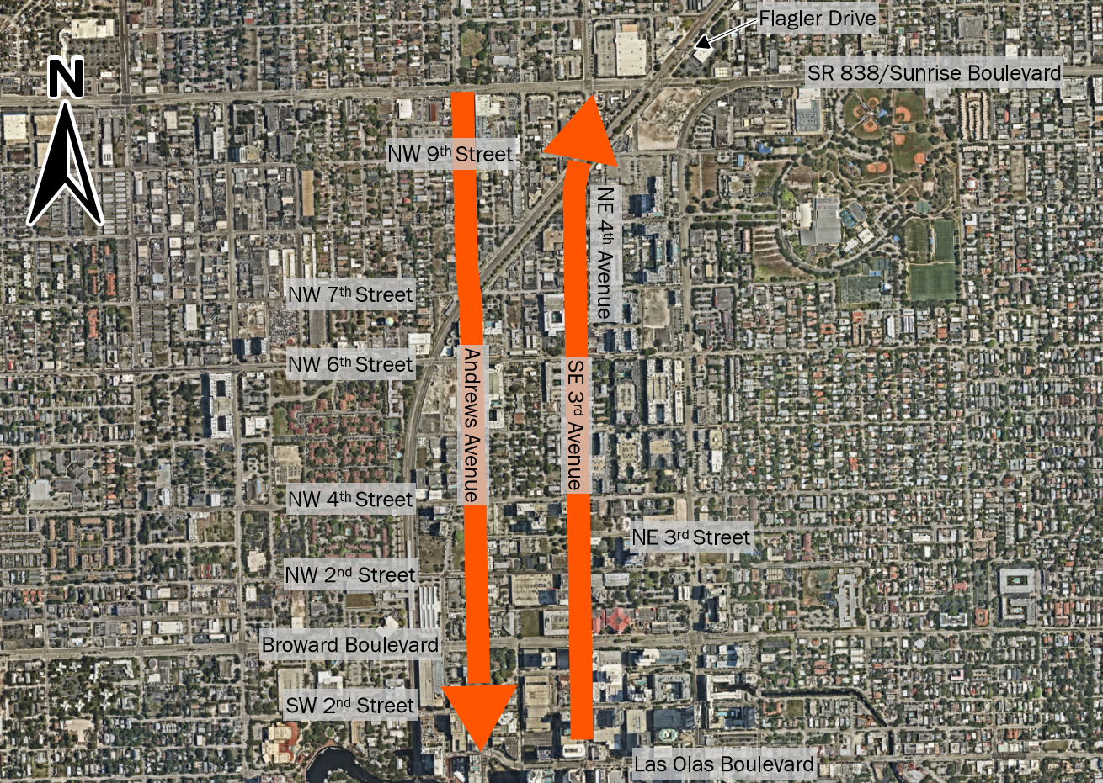
Scenario 1 Circulation

Slide 9
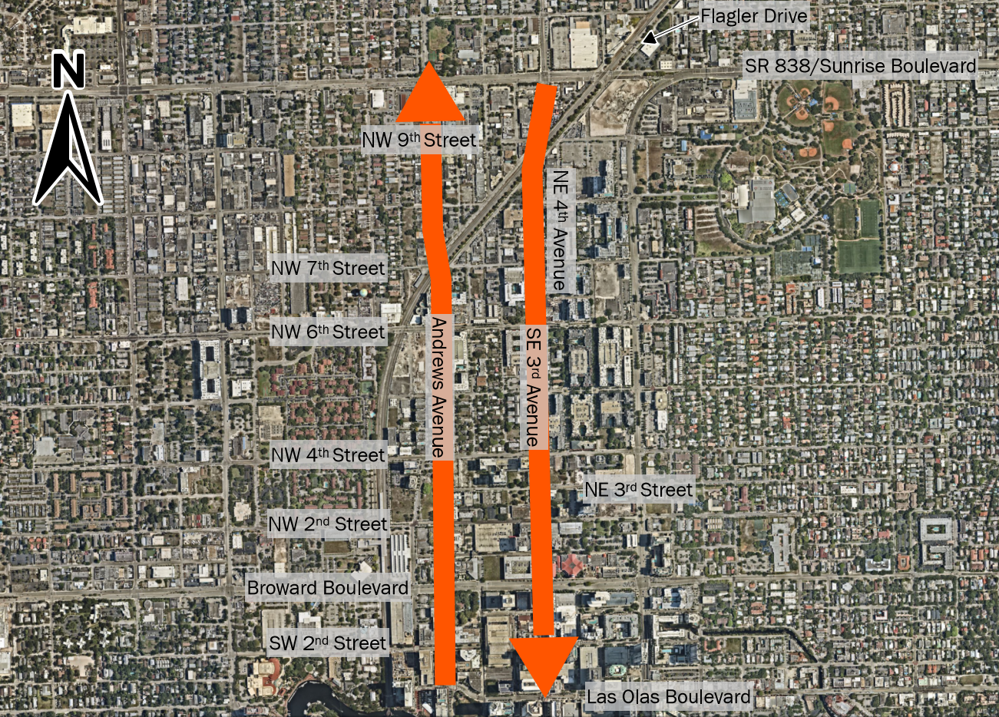
Scenario 2 Circulation

Slide 10
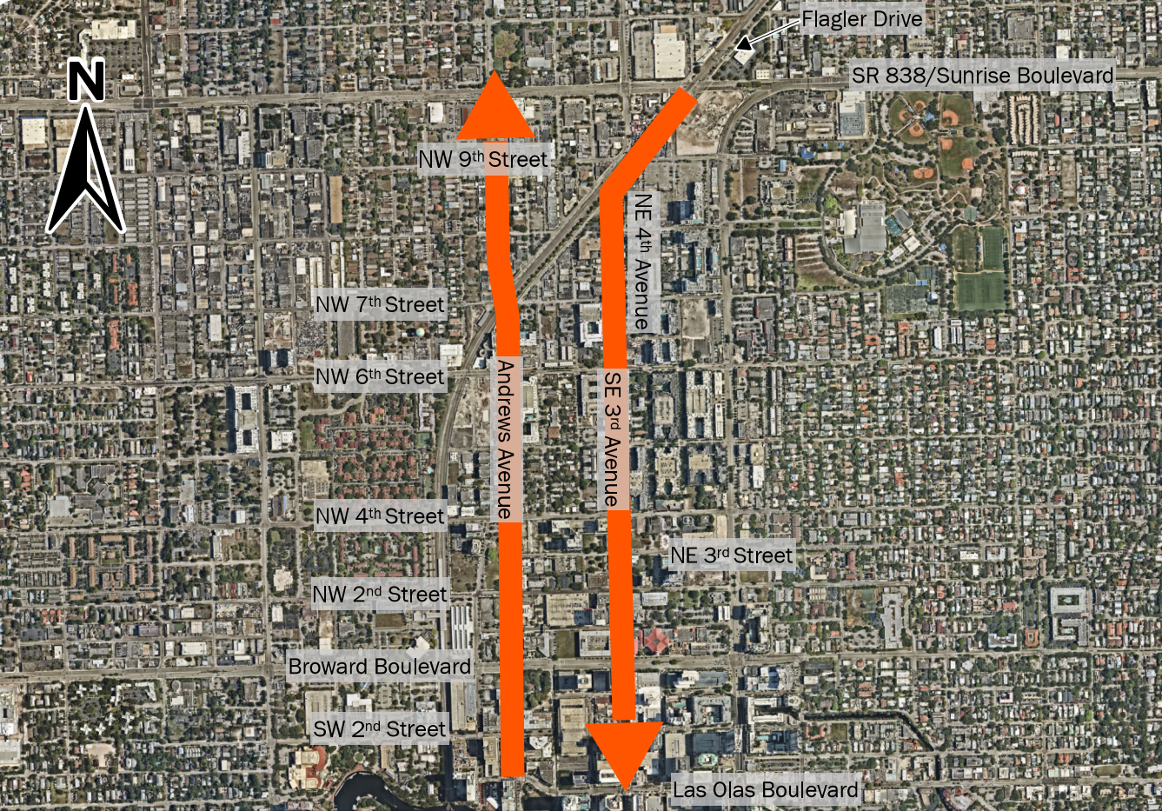
Scenario 3 Circulation

Slide 11
Project Tasks
Task 1: Agency/Public Meetings
  Coordination with public agencies and the public regarding the project
Task 2: Confirmation of Study Area Network and Methodology
  Public agency buy-in on analysis parameters
Task 3: Data Collection
  Intersection turning movement counts and roadway volumes within the study area
Task 4: Baseline Conditions Analysis
  Analysis of study intersections and roadways using existing traffic volumes and roadway geometry for weekday AM and PM rush hours

Slide 12
Project Tasks (Continued)
Task 5: Estimation of Future Year Travel Demand – Existing Two-Way Network
  Analysis of study intersections and roadways under future (2045) traffic conditions
Task 6: Feasibility Review
  Multimodal evaluation
  SWOT Analysis
    Constructability evaluation
    Downtown access and circulation impact evaluation, including access to and from major driveways
    Emergency response (police, fire-rescue and other emergency services response times)
    Economic sustainability
    Curbside Management
    Retail storefront exposure
    Accommodation of transit facilities and other multimodal mobility
    Sense of place considerations
    Effective use of right-of-way
    Transit accommodations
    Bicyclist accommodations
    Pedestrian accommodations

Slide 13
Project Tasks (Continued)
Task 7: Estimation of Future Year Travel Demand – One-Way Pair Scenarios
  Establish weekday AM and PM rush hour existing and 2045 volumes for one-way pair scenarios
Task 8: Future Conditions Operational Analysis
  Analysis of study intersections and roadways under existing and 2045 traffic conditions and proposed roadway geometry for all alternative scenarios
Task 9: Technical Report and Recommendations
  Documentation of findings from all analyses

Slide 14
Project Status
Task Number | Project Task | Status
1 | Agency/Public Meetings | Ongoing
2 | Confirmation of Study Area Network | Completed
3 | Data Collection | Completed
4 | Baseline Conditions Analysis | Completed
5 | Estimation of Future Year Travel Demand – Existing Two-Way Network | Completed
6 | Feasibility Review | Ongoing
7 | Estimation of Future Year Travel Demand – One-Way Pair Scenarios | Completed – Under Review
8 | Future Conditions Operational Analysis | Ongoing
9 | Technical Report and Recommendations | Ongoing

Slide 15
Project Status
Next Steps
Additional agency/public meetings
Feasibility Review
Analysis of one-way pair scenarios
Technical Report/Recommendations

Slide 16

Open Discussion

